Slide 1
Consumer Behaviour and Shopping Habits
Group #8
Naveen Kumar Reddy Singam
Tanushree Mahesh Kumar
Surya Vegesna
Muhammad Haris
Fall 2023 - MSA 8020 - Data Visualization Final Project Presentation
November 28, 2023

Slide 2
Introduction
The project analyzes E-commerce trends using the Consumer Behavior and Shopping Habits Dataset to understand shopper patterns.
Rich in demographic data, purchase history, and preferences, it guides businesses in tailoring marketing and optimizing products.
The goal is to boost customer satisfaction through strategic insights.

Slide 3
Dataset Info

Slide 4
Dataset Info
Purpose: The dataset provides insights into customer behaviour and purchasing patterns to help businesses tailor products, marketing, and customer experience
Content:
The dimensionality of the dataset is 3900 rows * 19 columns
The dataset features 5 numerical and 14 categorical columns
Potential Uses:
Optimize product offerings to align with customer preferences
Enhance marketing strategies based on purchasing trends
Improve customer satisfaction by understanding their shopping experience, ultimately driving sales and loyalty

Slide 5
Dataset Attributes
Customer Entity:
Customer ID, Age, Gender, Subscription Status, Previous Purchases,
Preferred Payment Method, Frequency of Purchases
Purchase Entity:
Item Purchased, Purchase Amount (USD), Payment Method, Shipping Type,
Discount Applied, Promo Code Used
Product Entity:
Category, Location, Size, Color, Season, Review Rating

Slide 6
Data Analysis

Slide 7
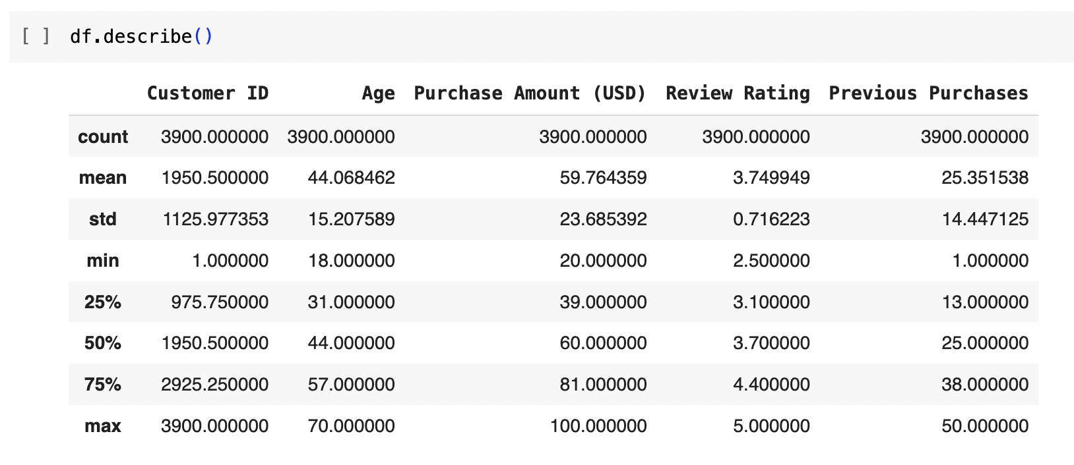
Statistics Review - 1
The average customer age is 44, ranging from 18 to 70 years old, and these customers have an average purchase amount of $59.76 while providing average product ratings of 3.74 stars.

Slide 8
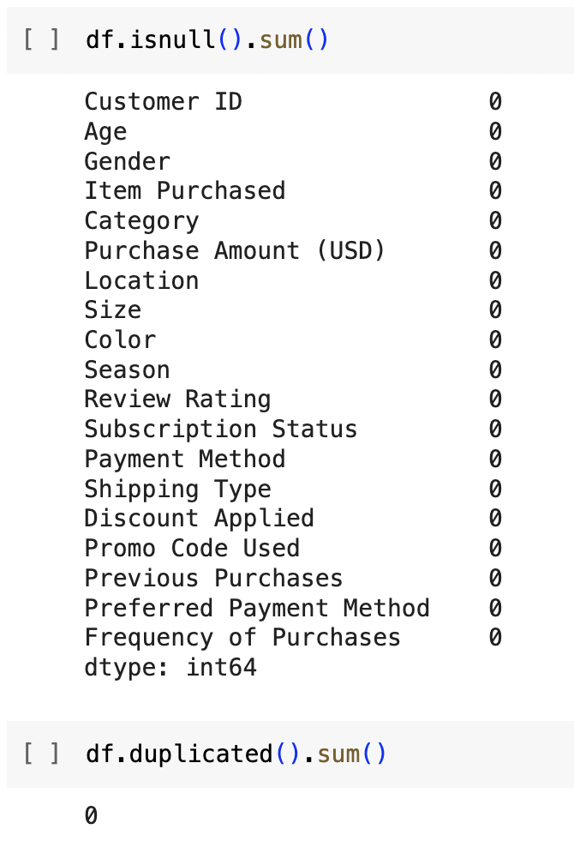
Statistics Review - 2
There are no null or duplicate values across the data columns, indicating complete and clean data suitable for analysis.

Slide 9
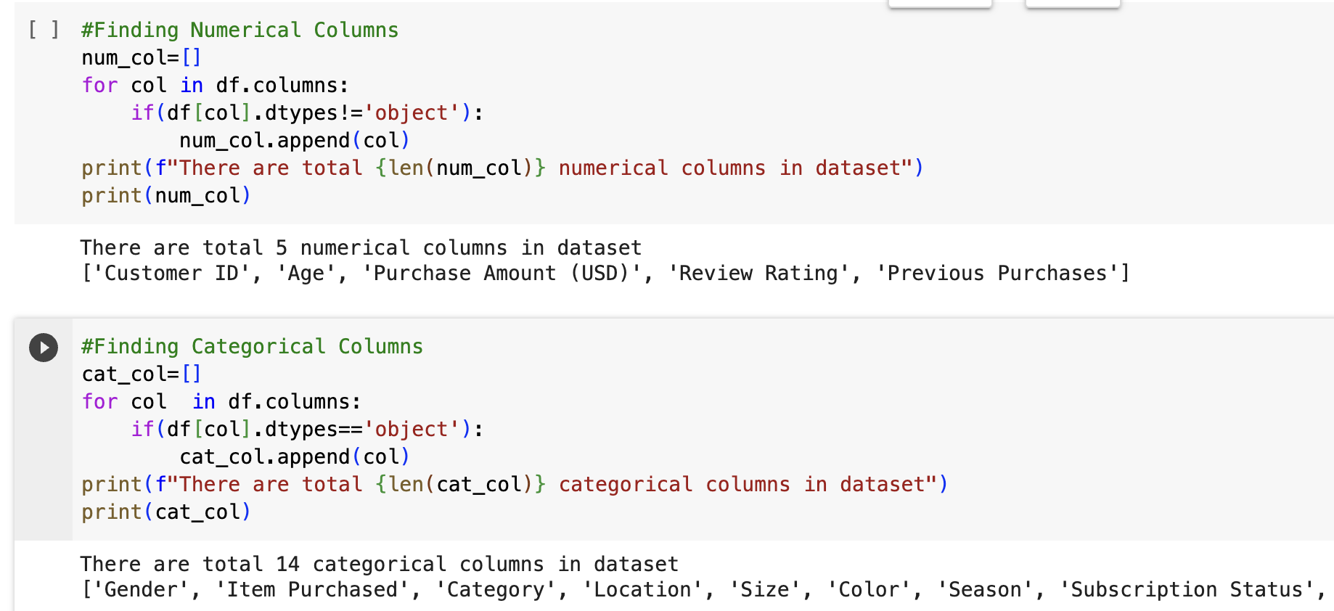
Statistics Review - 3
The dataset contains 5 numerical and 14 categorical columns, for a total of 19 data fields under analysis.

Slide 10
Insights
Notes:
Sri

Slide 11
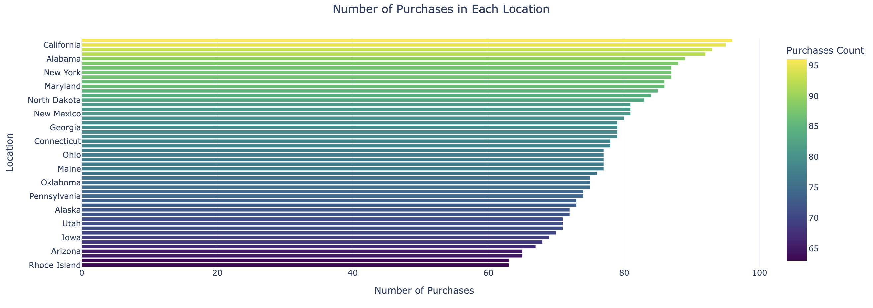
State Purchase Volume Analysis
The Horizontal Bar Chart shows the spread of purchase counts by state, with Montana having the most at 96 and Kansas and Rhode Island tied for the least at 63.

Slide 12
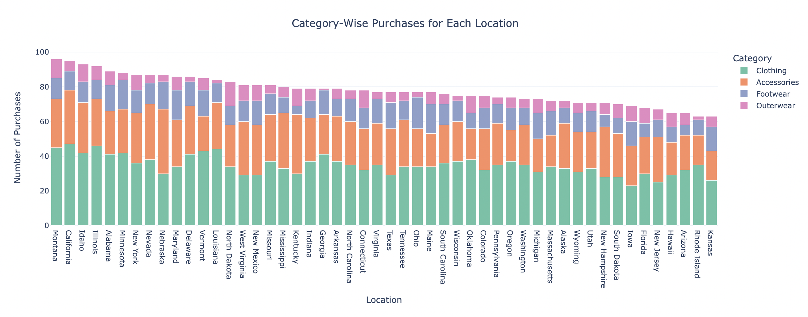
Where Are Shoppers Spending Most by Category?
The Stacked Bar Chart breaks down purchase counts by state across four categories - Clothing (California highest, Iowa lowest), Accessories (Nebraska highest, Kansas lowest), Footwear (Ohio highest, Kentucky lowest), and Outerwear (North Dakota highest, Georgia lowest).

Slide 13
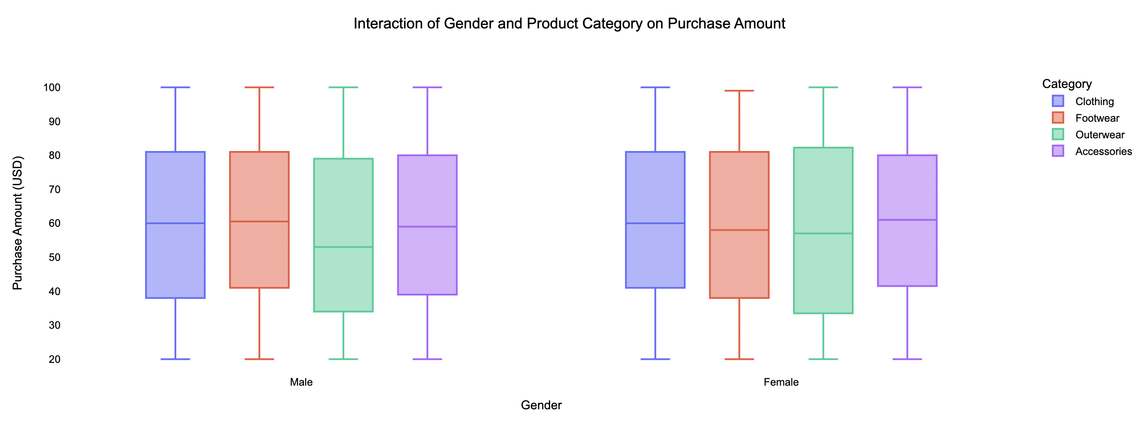
Analysing Spend Variance Across Genders by Segment
The box plots segment purchase amount distributions by product category and gender, revealing comparable median spending on Clothing, a slightly higher male median for Footwear (60.5 vs 58), a higher female median for Outerwear (57 vs 53), and a higher female median again for Accessories (61 vs 59).

Slide 14
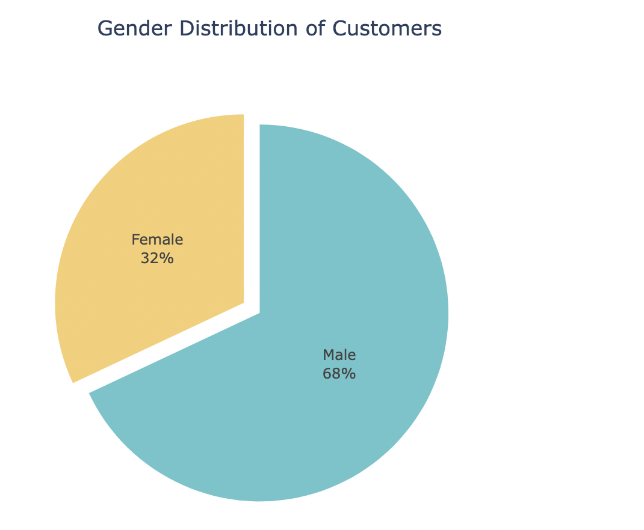
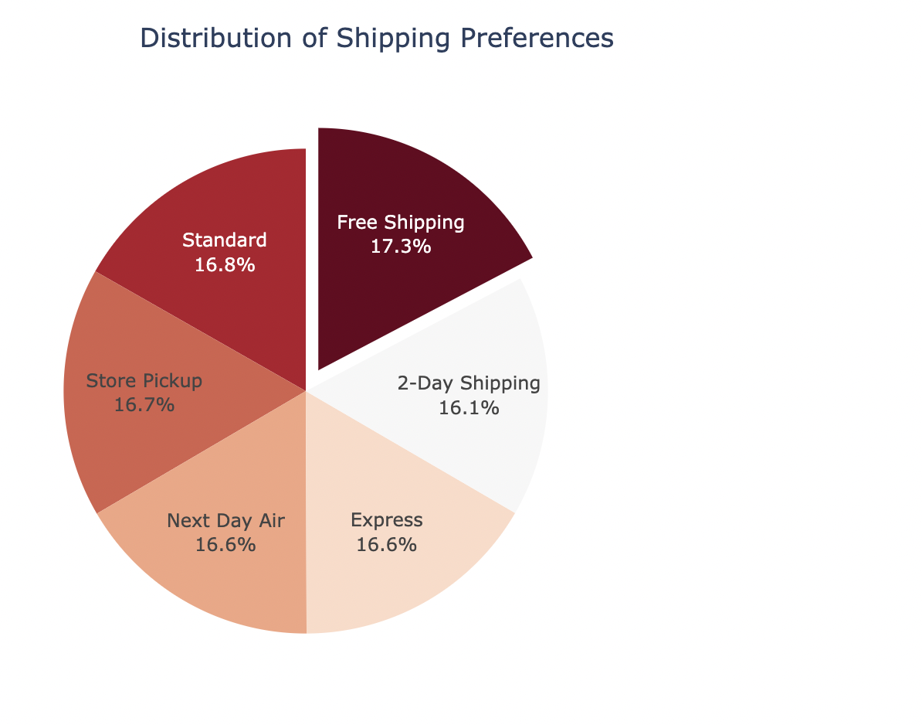
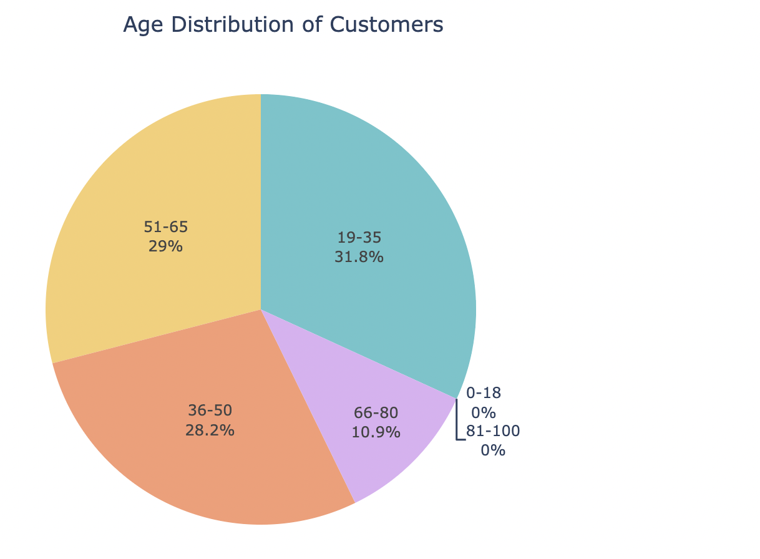
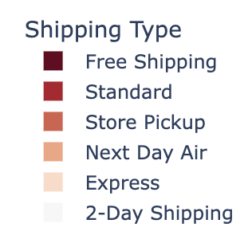
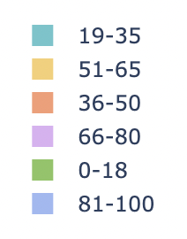
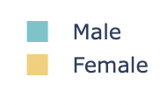
Customer Demographic Distributions
The first Pie Chart shows a 32% female and 68% male customer gender split.
The second Pie Chart breaks down shipping preferences, with Free Shipping the most popular at 17.3% followed by Standard, Store Pickup, Next Day Air, Express, and 2-Day.
The Pie Chart shows the age distribution of customers - 31.8% are 19-35 years old, 28.2% are 36-50 years old, 29% are 51-65 years old, 10.9% are 66-80 years old, and no customers are below 19 or over 80.

Slide 15
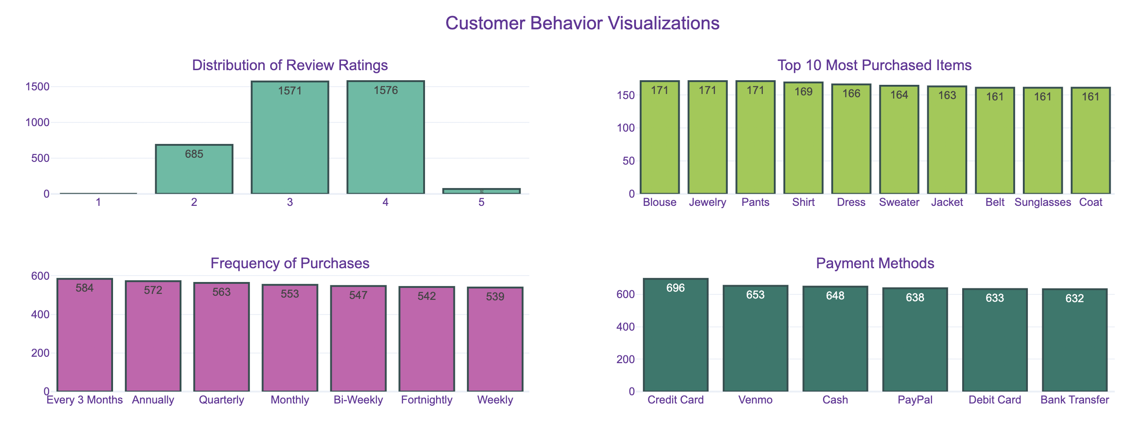
Mapping Customer Activity
The Histogram covers Review Ratings, Most Purchased Items, Purchase Frequency, and Payment Methods.

Slide 16
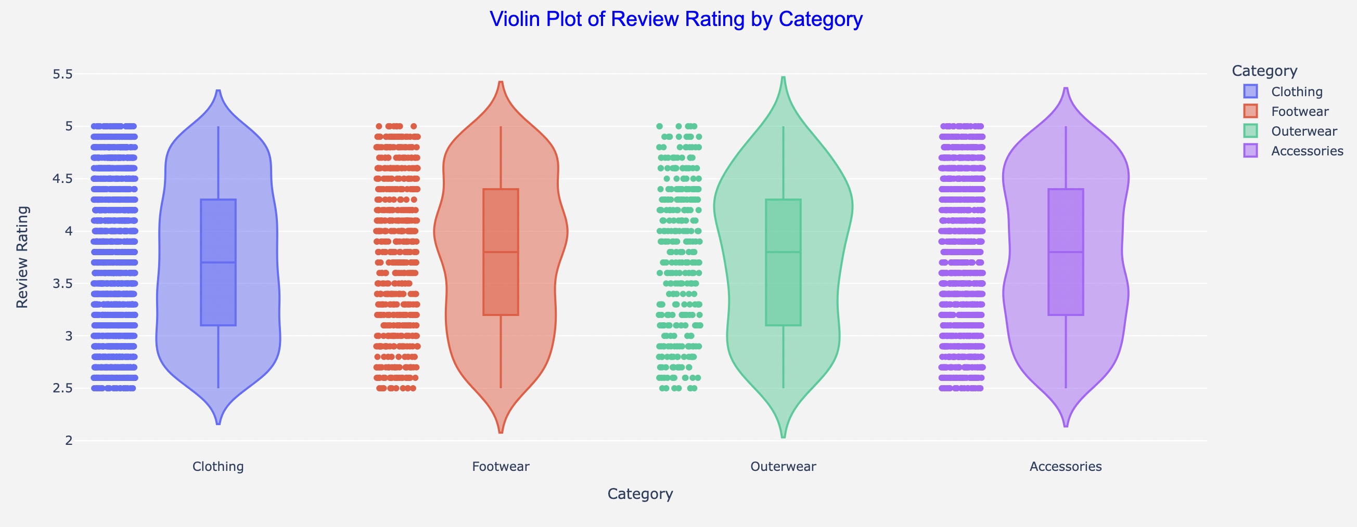
Product Segment Rating Distribution
The violin plot shows review ratings by product category, with footwear, outerwear, and accessories having a higher median rating (3.8) than clothing (3.7), indicating customers are slightly less satisfied with clothing purchases versus other categories.

Slide 17
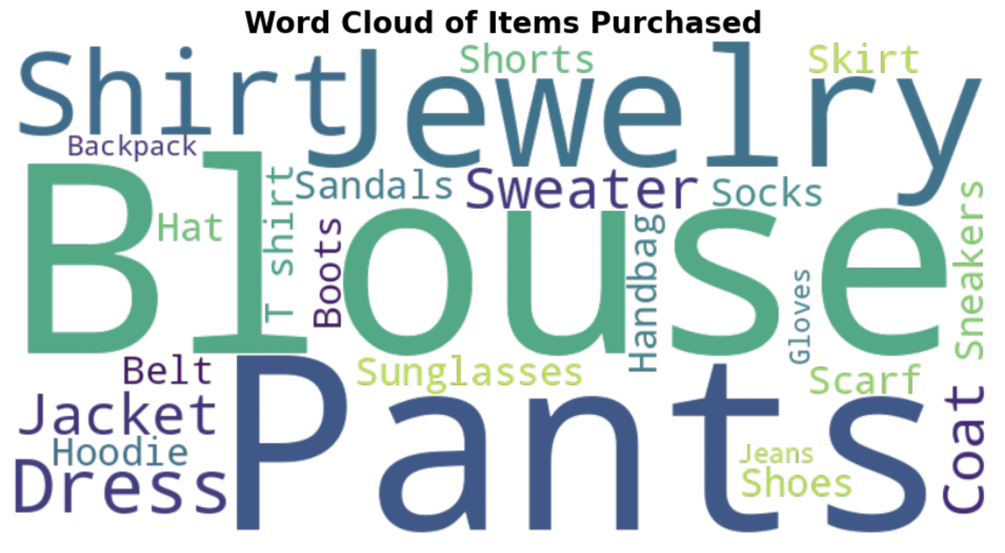
What Shoppers Are Buying Most?
The Word Cloud shows items purchased with font size representing quantity - Blouse, Pants, Jewelry and Shirt in larger fonts were purchased more often than less popular items like Sunglasses, Jeans and Gloves in smaller fonts.

Slide 18
Conclusion
Purchase volumes vary widely by state - target marketing to weaker states
Males outspend females across categories - close spending gap
Peak purchase activity in spring, lows in summer - optimize operations and promotions around demand swings
Lower ratings for clothing purchases than other categories - boost clothing satisfaction
Balanced payment method usage currently - expand options to improve convenience and conversion

Slide 19
Member Contribution

Slide 20
Contribution
Naveen Kumar Reddy Singam – Involved in applying specific design concepts, such as color theory and Gestalt principles, as well as incorporating interactive elements and engaged in pulling effective insights for PowerPoint presentations.
Tanushree Mahesh Kumar – Crafted and communicated a compelling narrative for data and findings and synthesized team efforts into a coherent story, emphasizing key insights for every EDA/Visualization trend on the Google colab. Additionally, prepared the final presentation, ensuring effective communication of findings and the data's story in an engaging manner.
Surya Vegesna – Performed exploratory analytics employing statistical tools and techniques for pattern discovery, trend analysis, and outlier identification and enabled multifaceted data understanding, cementing foundations for ongoing modeling, prediction, and decision systems while ensuring no integrity dilution and contributed to the preparation of project document/report.
Muhammad Haris – Leveraged data integration skills to identify, acquire, and refine relevant data repositories and conducted hands-on ETL activities to consolidate sources into analysis-friendly datasets, elevating quality while enabling rapid insights.
Notes:
Charanya

Slide 21
Any Questions?

Slide 22
Thank You!

